Slide 1

Passengers Occupancy Level Analysis
Achmad Rizky Akbar

Slide 2
Table of Contents
Introduction
Analysis
Recommendation and Conclusion
Notes:
Presentasi ini akan mencakup perkenalan, analysis, dan yang terakhir adalah rekomendasi dan keismpulan

Slide 3
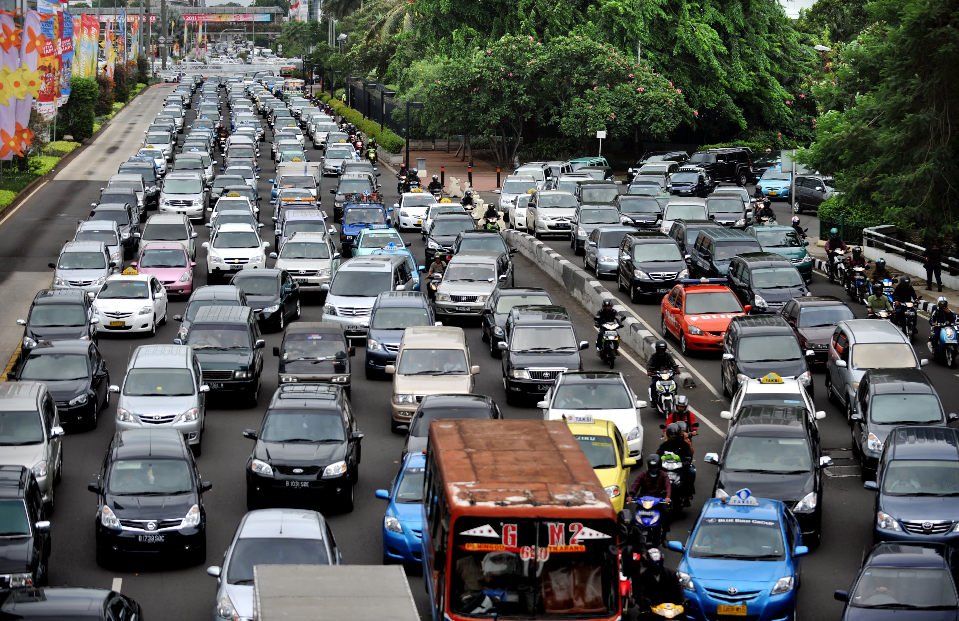
Introduction
Traffic Congestion is a major problem in most of Metropolitan cities.
Jakarta is the second most congested city in Indonesia. (INRIX, 2021).
Transjakarta is one of measure to decrease traffic congestion.
Notes:
Salah satunya dengan mengembangkan sarana transportasi umum, yaitu Transjakarta

Slide 4
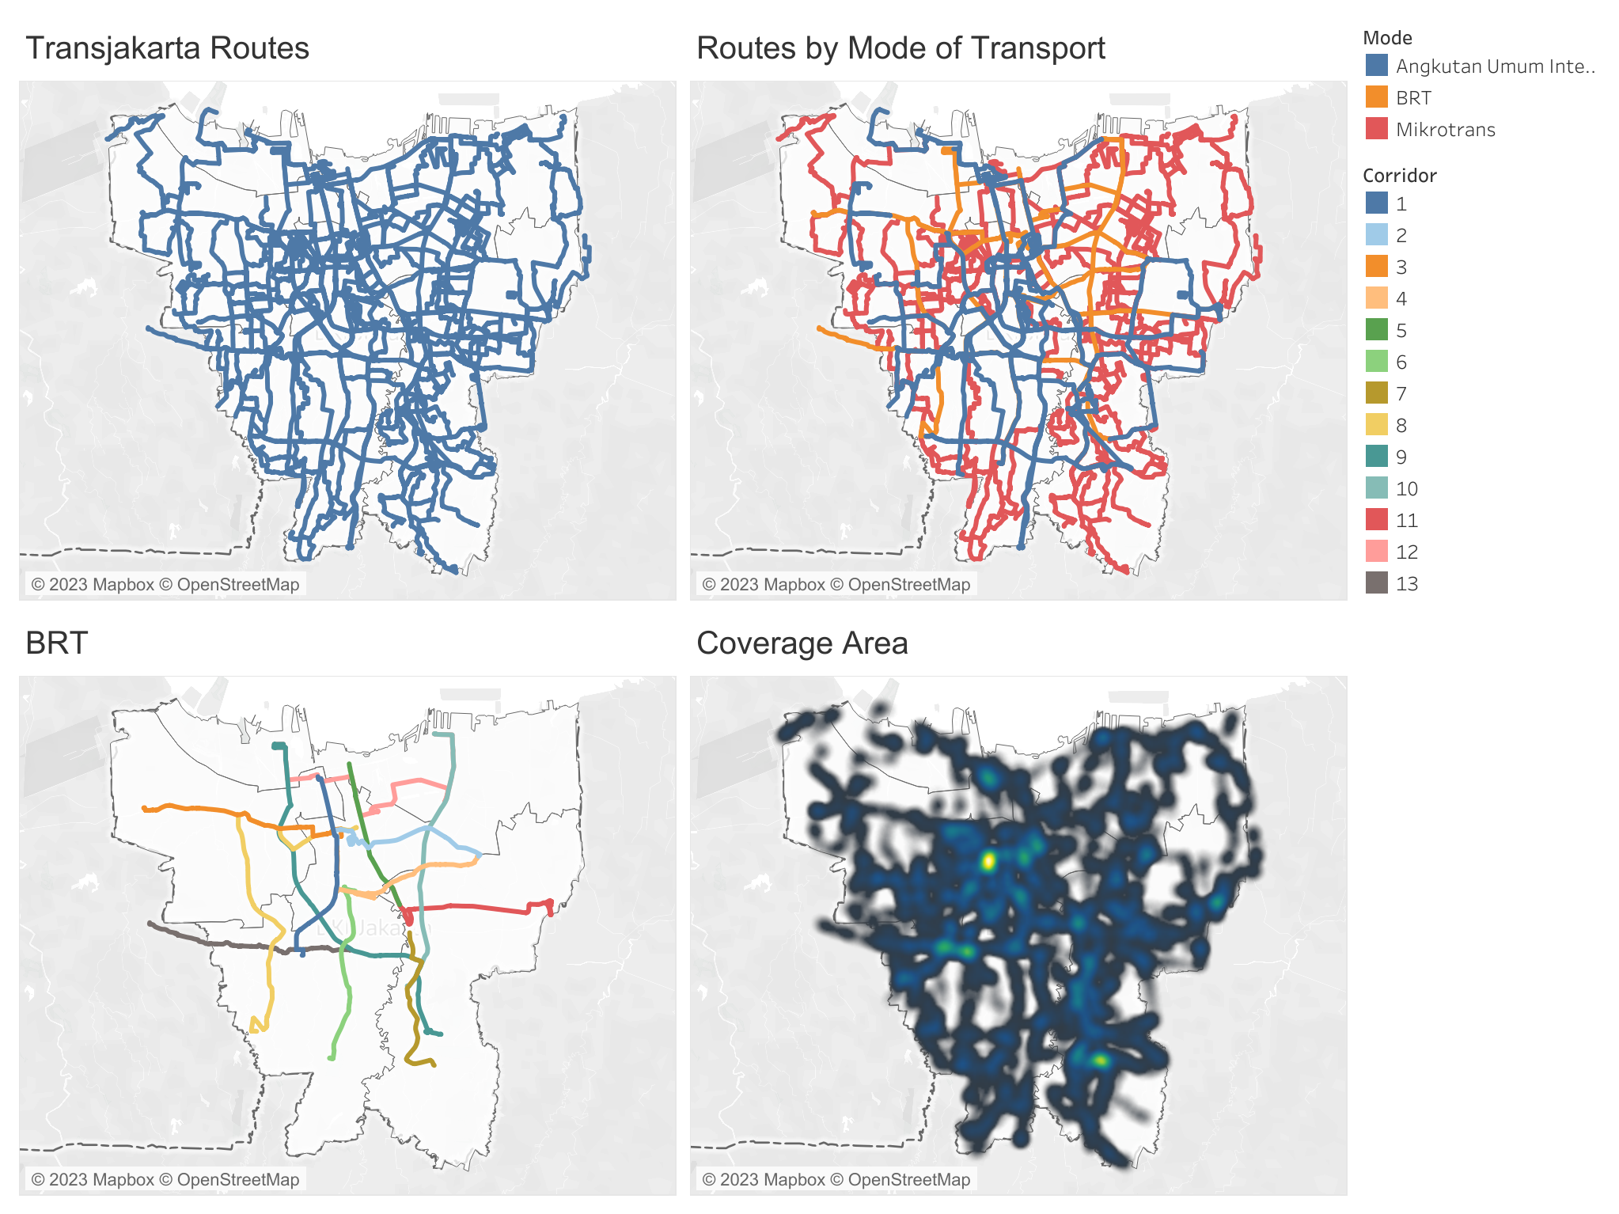
Transjakarta
A public transportation system in Jakarta.
Mode of Transport:
Bus Rapid Transit (BRT).
Angkutan Umum Integrasi.
Mikrotrans.
232 routes:
13 Main Transjakarta Corridors.
Notes:
Menandakan banyaknya rute koneksi

Slide 5
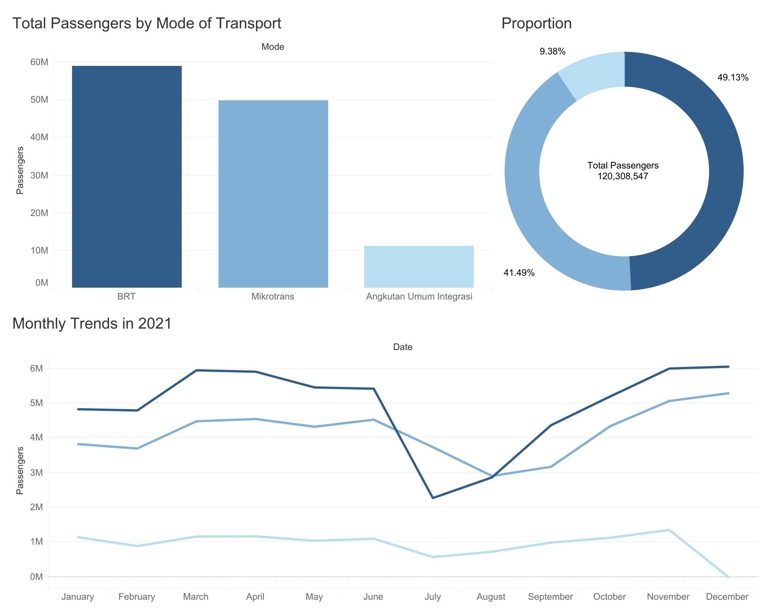
Transjakarta 2021
BRT is the most used mode of transport.
It counts almost half of the proportion.
Side-way trends with significant declines in June.

Slide 6
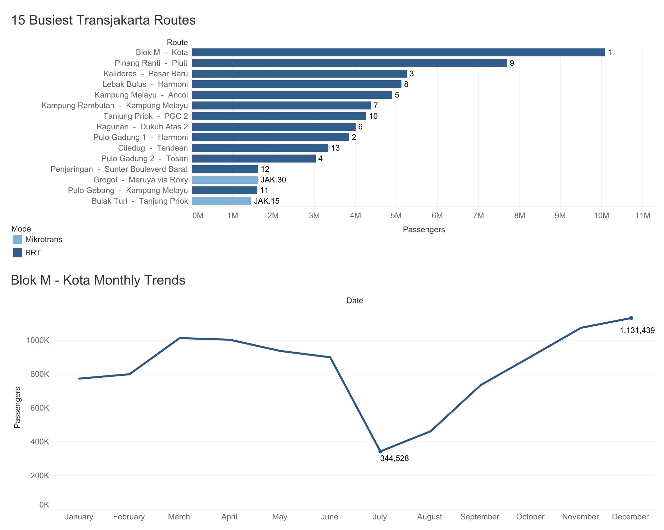
Busiest Routes
Dominated by BRTs.
Corridor 1 is the busiest route.

Slide 7
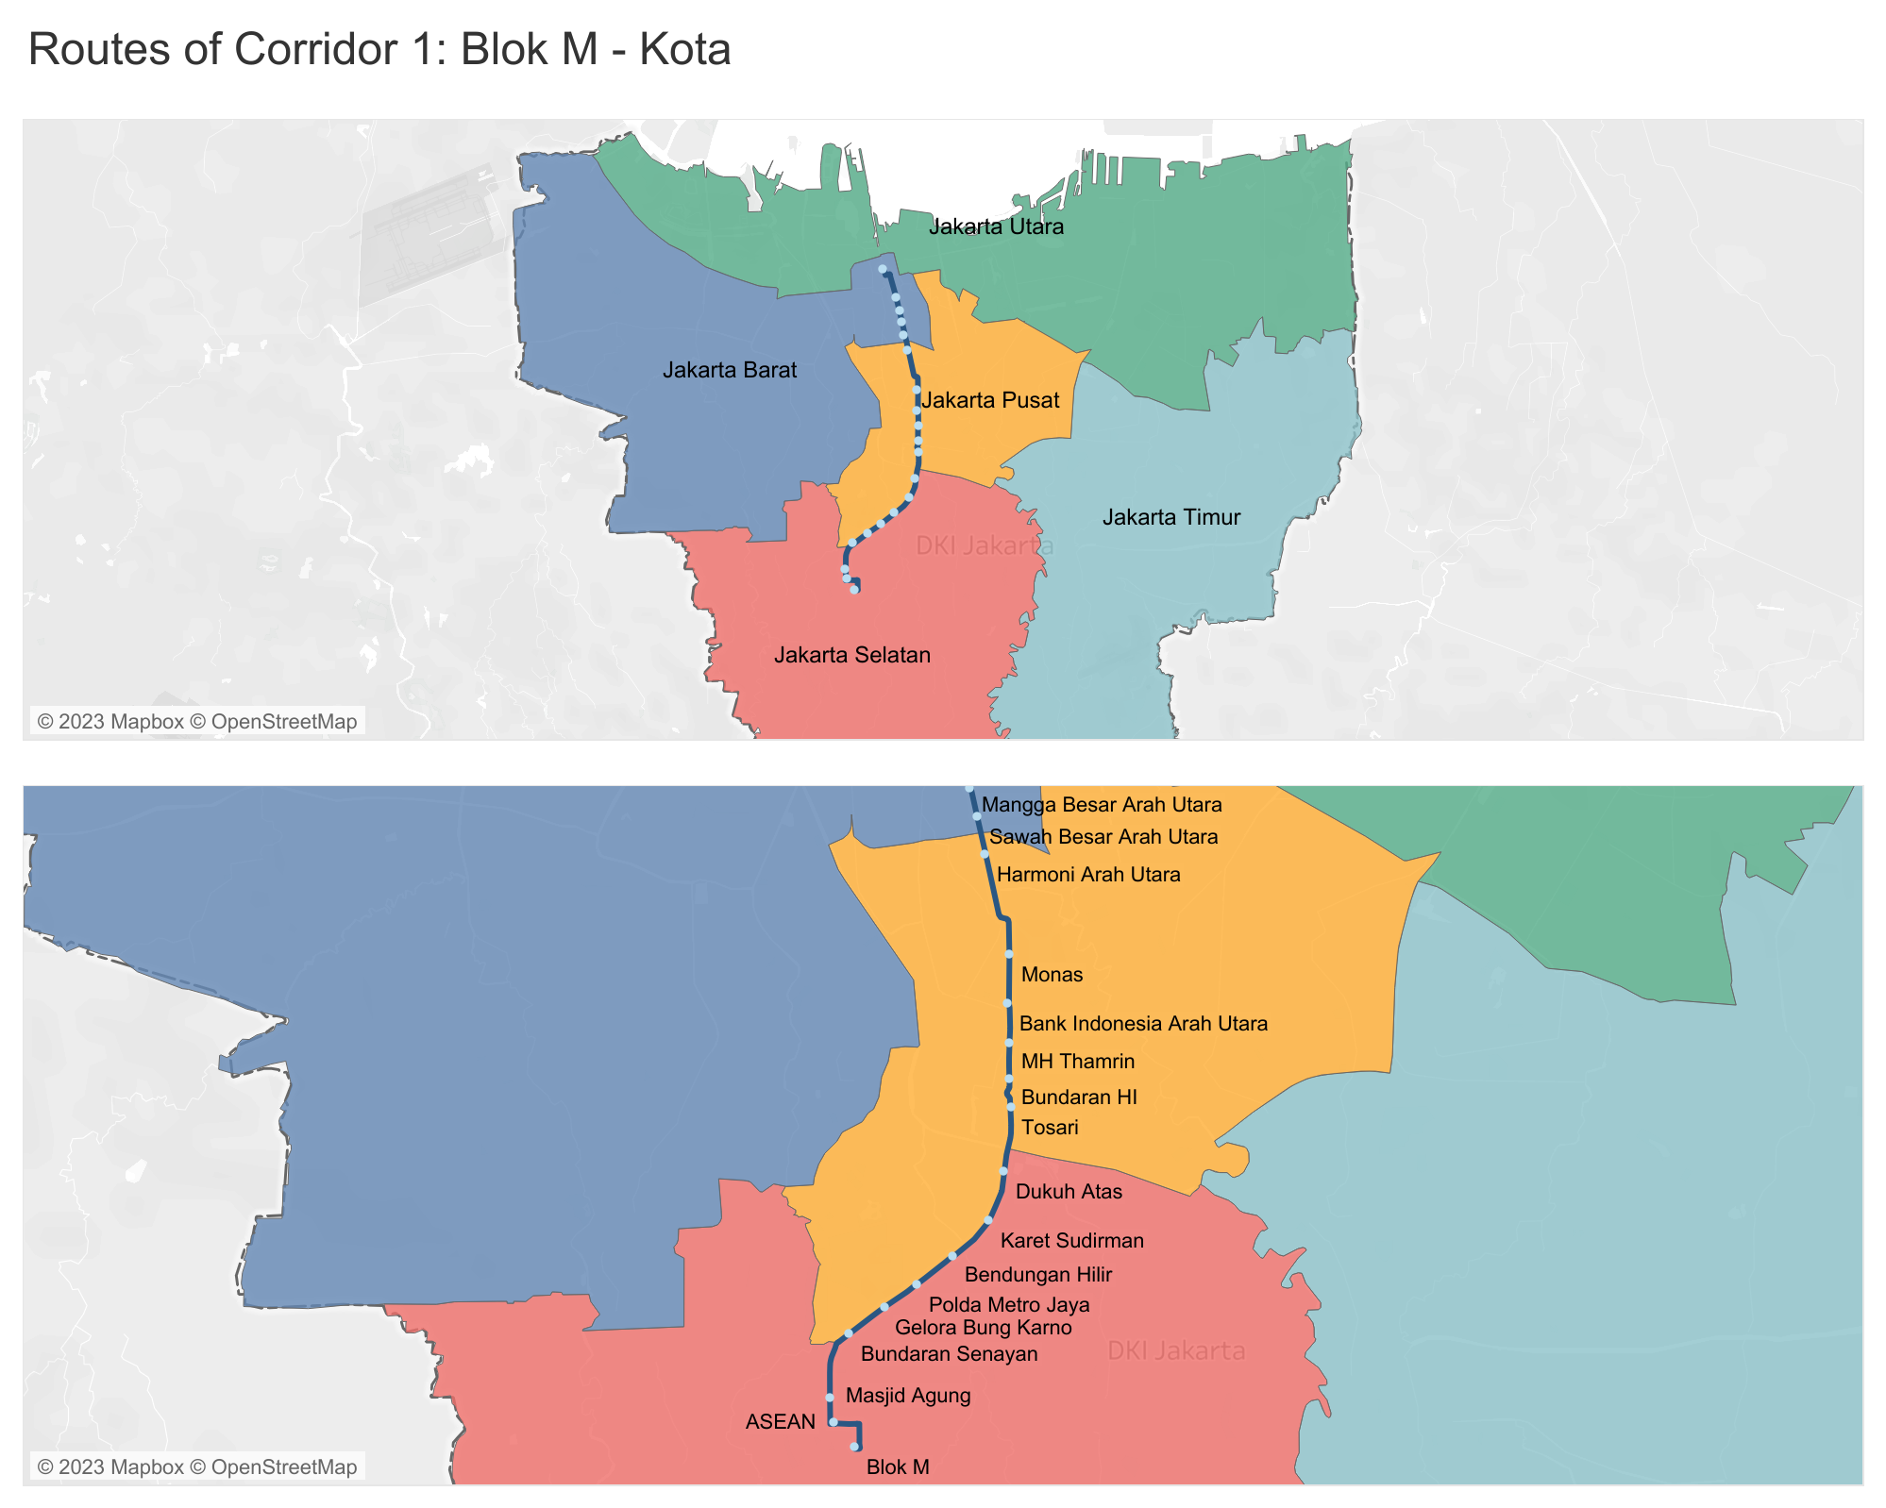
Corridor 1: Blok M - Kota
Connects South Jakarta and West Jakarta through Center Jakarta.
Passes through important business districts.

Slide 8
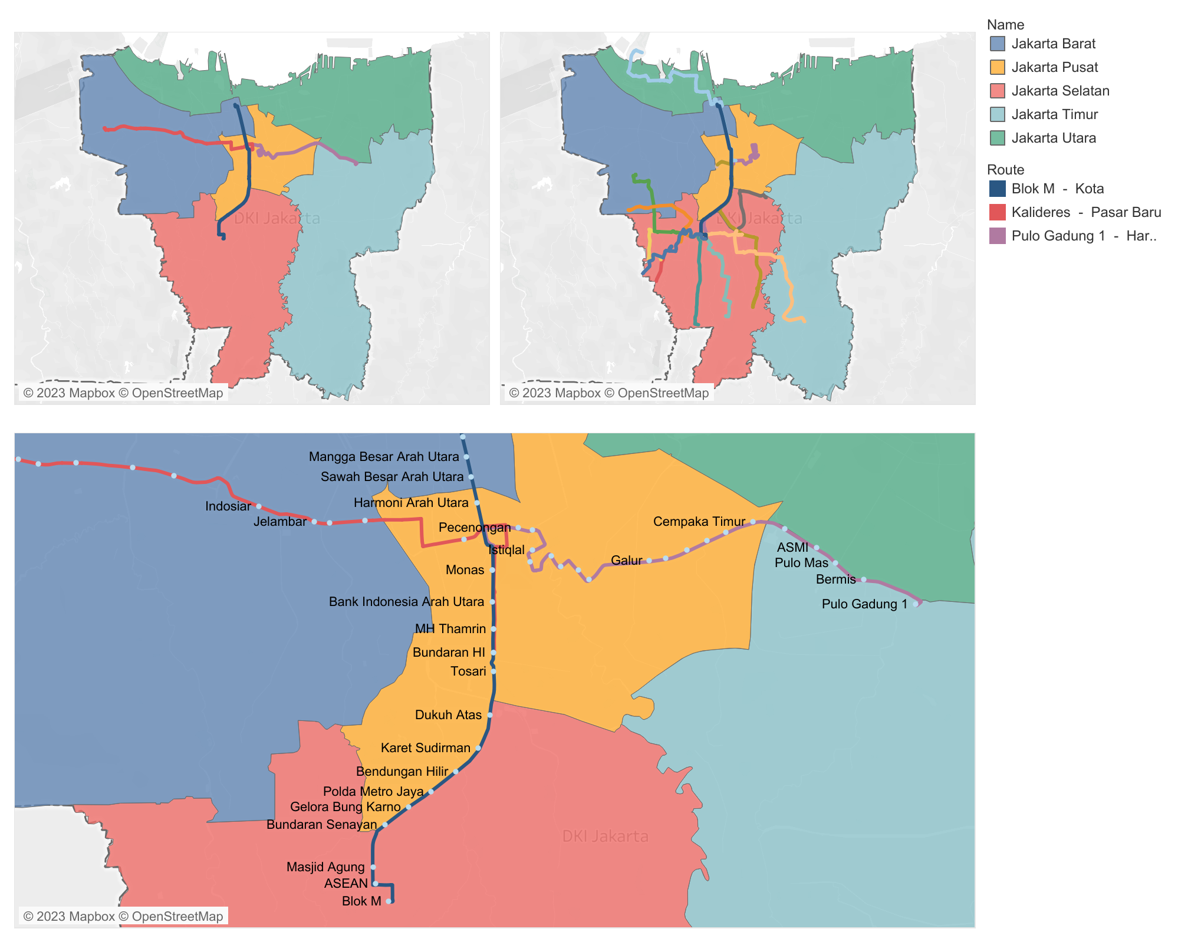
Transits of Corridor 1
As a key transit point of other corridors.
As connecting routes from residential to commercial areas.

Slide 9
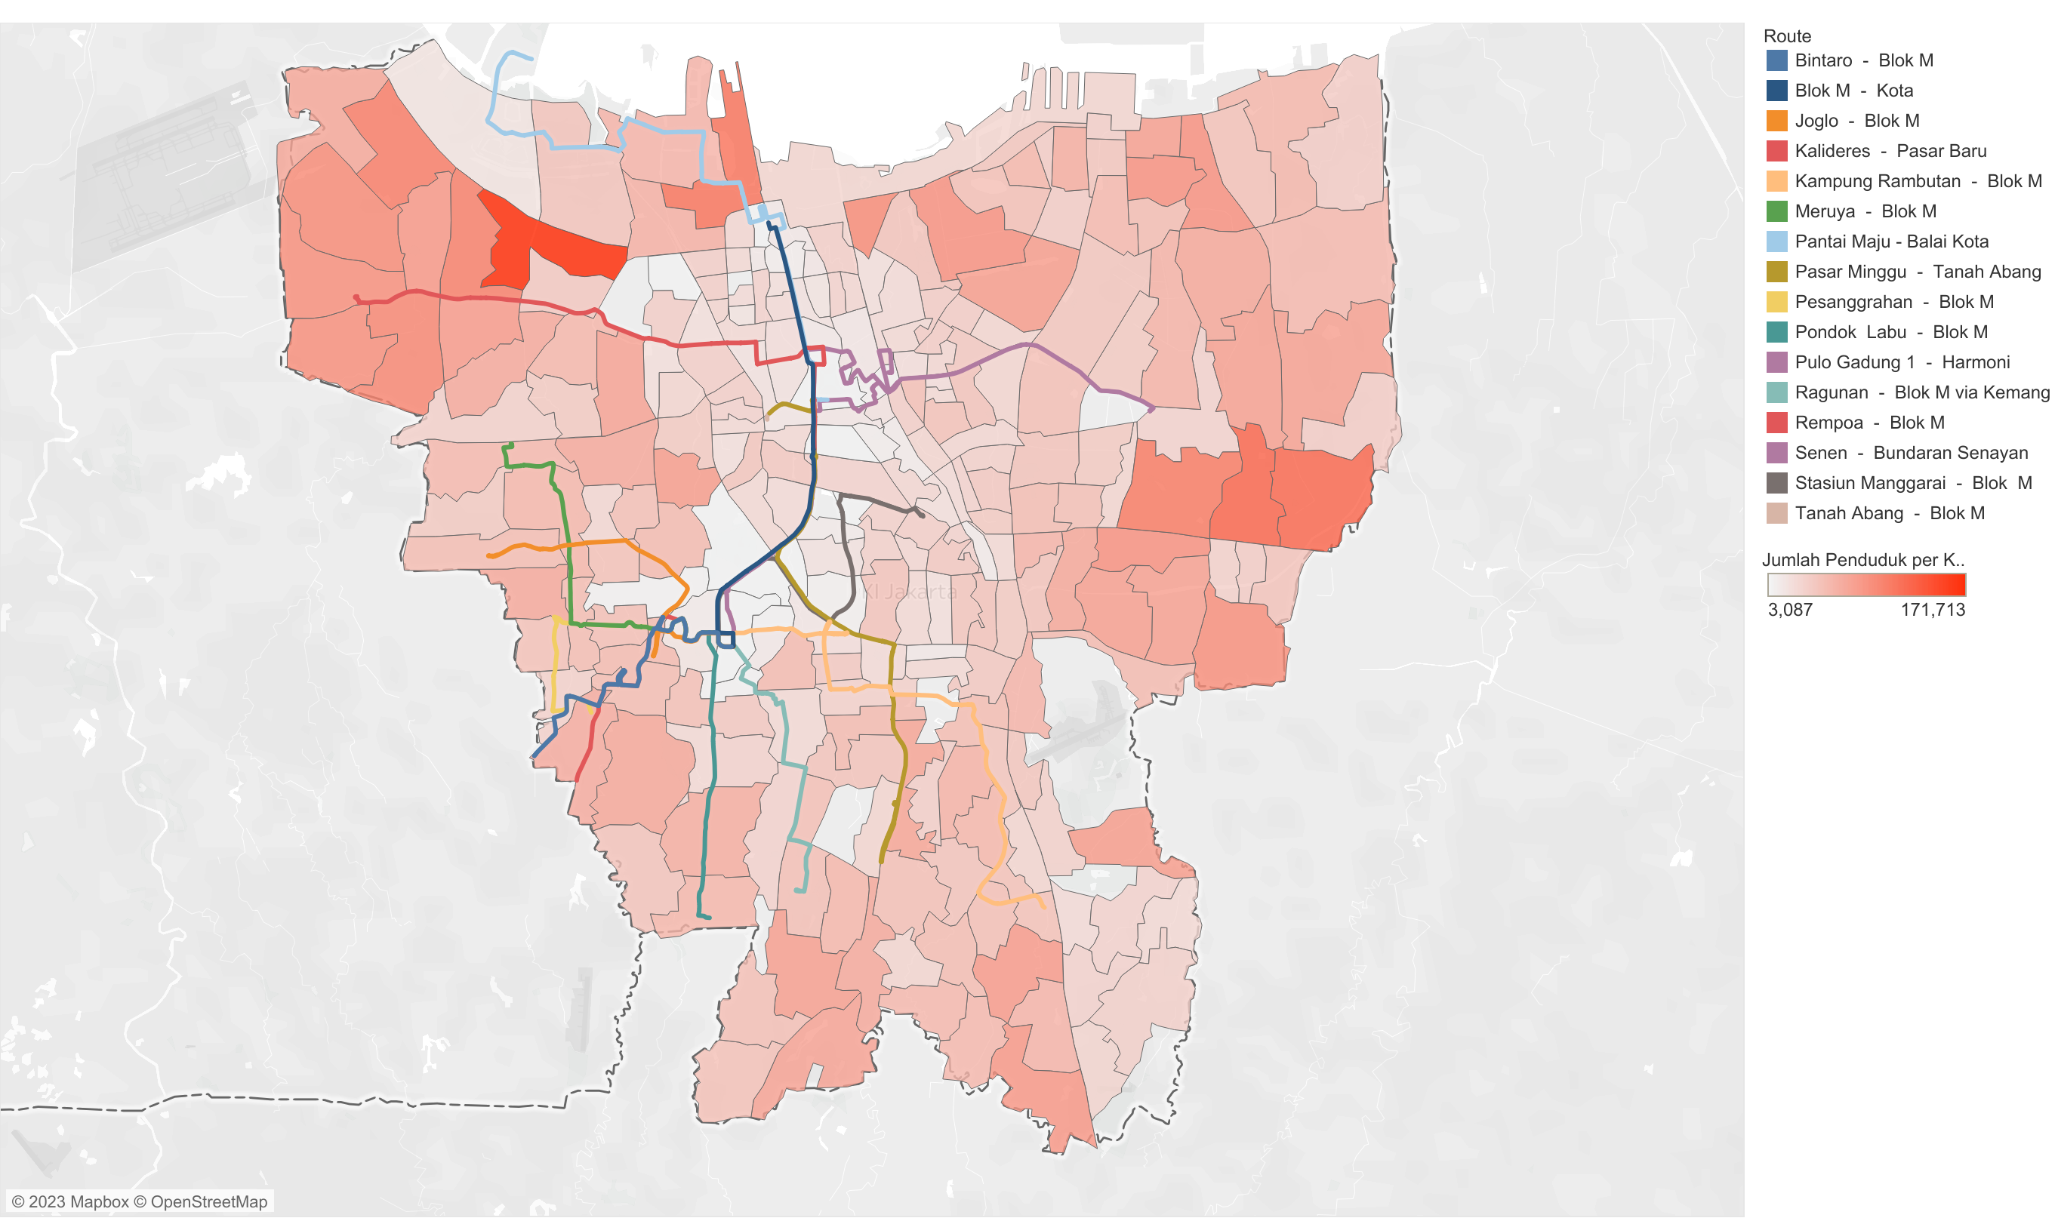
2019 Population Density by Sub-District

Slide 10



Passengers Occupancy Analysis
Period | Start Time | End Time | Headway in Second | Total Minutes | Headway in Minutes | Total Trip per Period
1 | 5.00 | 6.00 | 180 | 60 | 3 | 20
2 | 6.00 | 9.00 | 90 | 180 | 1.5 | 120
3 | 9.00 | 16.00 | 180 | 420 | 3 | 140
4 | 16.00 | 20.00 | 90 | 240 | 1.5 | 160
5 | 20.00 | 22.00 | 180 | 120 | 3 | 40
 |  |  |  |  | Total Trips in a Day | 480
$$Total trips=480 \\ Total passengers=901,806 \\ Bus capacity=60$$
Insights:
Occupancy rate exceeds 100%, meaning the corridor is overcrowded.
$$Total capacity=Bus capacity×Total trips×30 \\ =60×480×30 \\ =864,000$$
$$Occupancy rate=Total passengers÷Total capacity \\ =901,806÷864,000 \\ =104.38\%$$

Slide 11
Recommendations and Conclusion
Recommendations:
Short-term : Increase the frequency of buses.
Long-term : Build necessary infrastructures such as Subways.
Conclusion:
Overall, Transjakarta existence is important to support the mobility of people, especially corridor 1: Blok M – Kota.
Thus, Its performance and quality is expected.
Therefore, knowing the result of the analysis, it is possible to consider an improvement in the future.

